Slide 1
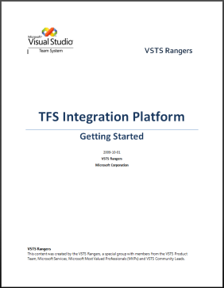
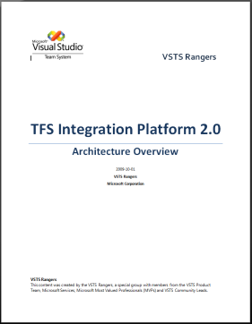
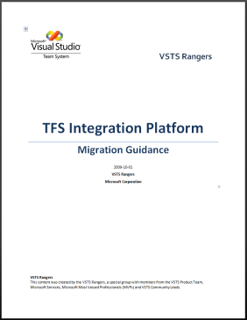
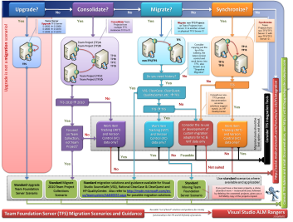
TFS Integration Tools - Planning
Continuously re-evaluate your environment
Inception
Elicitation
Elaboration
Pilot
Adopt
Understand …
Your environment
Your requirements
Off-the-shelve solutions
Contact …
VSTS Rangers
Requirements
Prioritize
Match to solutions
Find possible scenario(s)
Refine Scenarios
Define Infrastructure
Define Session Types
Determine customization
Familiarize with product(s)
Calculate production impact
Prototype “your” environment
Monitor
Re-evaluate
Impact
Time
Scenario Time
Downtime
Environment
Support
Maintenance
Training
Process
Part-time
Ongoing
Migration
Snapshot Migration
Selected History Migration
Archive Migration
Synchronization
Simple
Multiple
Full
Refer to “Getting Started”
Refer to “Migration Guidance”
Refer to:
“Architecture Overview”
“Custom Adapter POC”
Direction
One-way
Two-way
Type
WIT
VC
WIT
[op1 ] Source Delta Computation
[op2 ] Source Link Delta Computation
[op3 ] Target Delta Computation
[op4 ] Target Link Delta Computation
[op5 ] Migration Instruction Generation
[op6 ] Basic Conflict Analysis
[op7 ] Revisions Migration
[op8 ] Target Link Delta Computation
[op9 ] Link Translation/Analysis
[op10] Link Migration
WITs
Source → Target (1,5,7)
Target → Source (1,3,5-7)
Links
Source → Target (2,9,10)
Target → Source (8,9,10)
Work items
revs/min¹
Minutes
Minutes
/ 5 =
+
Minutes
/ 5 =
+
/ 30 =
+
/ 30 =
NOTE
¹The revs/min are estimates based on an average 10 revisions per work item and an average of 2 links per work item.
Upgrade is almost always the right choice when it is an option. Upgrade is a lossless process that minimizes migration and on-going maintenance time, effort and cost.
References Visual Studio ALM Rangers, Copyright © 2010 Microsoft Corporation TFS Integration Solutions http://msdn.microsoft.com/en-us/teamsystem/bb840033.aspx Rangers http://msdn.microsoft.com/en-us/teamsystem/ee358786.aspx

